Slide 1
Inferential Stats

Slide 2
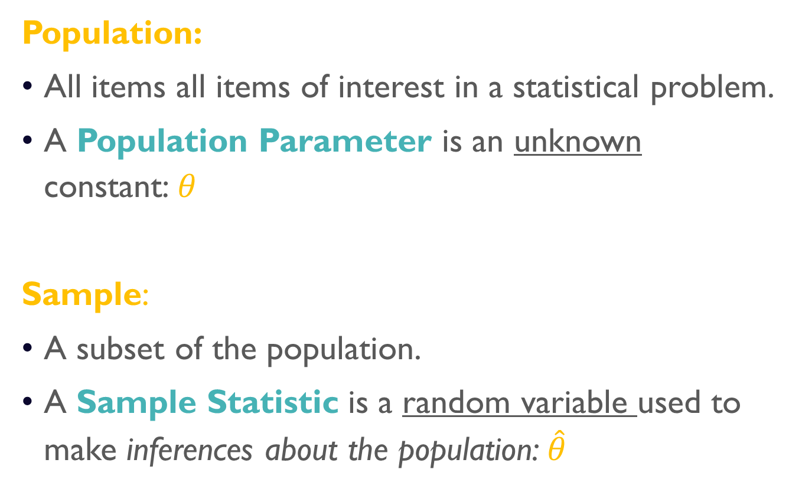
Parameters vs statistics
Population:
All items all items of interest in a statistical problem.
A Population Parameter is an unknown constant:$θ$
Sample:
A subset of the population.
A Sample Statistic is a random variable used to make inferences about the population: $\hat{θ}$

Slide 3
Estimator vs. Estimates
Estimator:
A sample statistic used to estimate a population parameter.
Estimate:
A particular value of the estimator.

Slide 4
Properties of point estimators
Unbiased:
A point estimator is unbiased if its expected value equals the unknown population parameter.
Efficient:
An unbiased point estimator is efficient if its standard error is lower than that of other unbiased estimators.
Consistent:
A point estimator is consistent if approaches the unknown population parameter as the sample size grows larger.

Slide 5
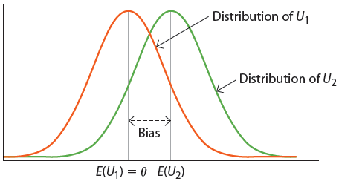

unbiasedness
$U_{1}$ is an unbiased estimator of the true population parameter $θ.$
$U_{2}$ is a biased estimator of the true population parameter $θ.$

Slide 6
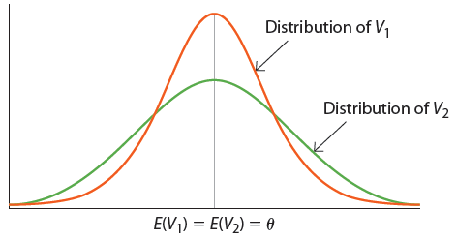

Efficiency
Both $V_{1}$ and $V_{2}$ are unbiased estimators of the true population parameter $θ.$
Yet, $V_{1}$ is more efficient as it is less variable as it has smaller variance (and smaller standard error).

Slide 7
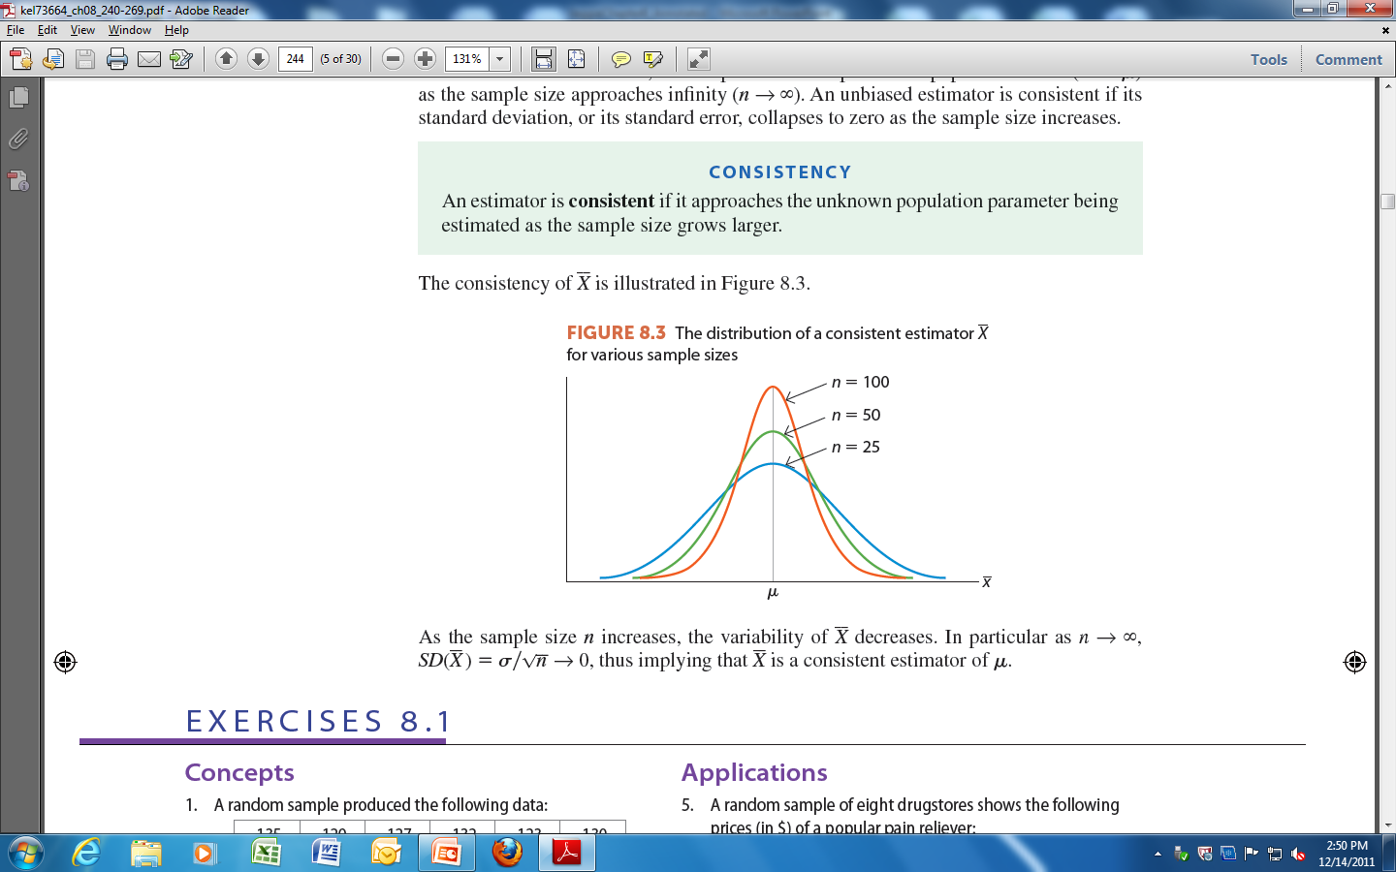

Consistency
As the sample size increases the variability the sample mean $\overline{X}$decreases, until it becomes bunched around the population mean, $μ$.
In particular, as $n→∞, SD\left(\overline{X}\right)=σ/{\sqrt{n}}→0$. Thus, $\overline{X}$is a consistent estimator of $μ$.

Slide 8
Point vs. interval estimation
Point Estimator:
A function of the random sample used to make inferences about a single value of an unknown population parameter.
Interval Estimator:
A function of the random sample used to make inferences about the range of plausible values of an unknown population parameter.

Slide 9
Central limit theorem
Sampling & Sampling Distributions

